Slide 1


CMR TECHNICAL CAMPUS UGC AUTONOMOUS Accredited by NBA & NAAC with ‘A’ Grade Approved by AICTE, New Delhi and JNTU, Hyderabad Kandlakoya(V), Medchal Road, Hyderabad-501401, Telangana Department of Computer Science and Engineering MODELING AND PREDICTING CYBER HACKING BREACHES
BATCH NO : 06
Madala Hemanth 207R1A0593
Jupalli Venkata Sai 207R1A0582
Nimmala Nithish 207R1A05A7
Under the Guidance of
B.P Deepak Kumar

Slide 2
CONTENTS
Abstract
Introduction
Existing system
Disadvantages of existing system
Proposed system
Advantages of proposed system
Hardware and software requirements
Novelty
Architecture
Modules
UML Diagrams
Sample Code
Results
Conclusion
References
Github Link

Slide 3
ABSTRACT
Analyzing cyber incident data sets is crucial for understanding the evolving threat landscape.
The project focuses on a breach incident data set covering 12 years (2005-2017) of cyber hacking activities, including malware attacks.
The study challenges existing findings in the literature by suggesting that both hacking breach incident inter-arrival times and breach sizes should be modeled using stochastic processes rather than distributions due to the presence of autocorrelations.
Qualitative and quantitative trend analyses are conducted on the data set to gain deeper insights into the evolution of hacking breach incidents.
The analysis reveals cybersecurity insights, such as the increasing frequency of cyber hacks but no corresponding increase in the magnitude of damage caused.

Slide 4

INTRODUCTION
Society's reliance on technology and digital communication has increased.
This has resulted in a rise in cyber attacks and data breaches.
Cyber attacks involve exploiting vulnerabilities to gain unauthorized access or cause damage.
Data breaches involve unauthorized access or theft of sensitive information.
These incidents can lead to financial losses, reputational damage, and legal consequences.
Effective cybersecurity measures are necessary to mitigate the risks associated with cyber attacks and data breaches.

Slide 5
EXISTING SYSTEM
The study aims to investigate the trend of data breaches caused by cyber attacks.
Previous studies had limitations: one had a limited time span (2000-2008) and may not include cyber attack-related breaches, while another included both negligent and malicious breaches.
Negligent breaches caused by human errors are excluded from the study.
The study focuses specifically on the hacking sub-category of malicious breaches.
The other sub-categories (insider, payment card fraud, unknown) will be analyzed separately.
The study seeks to provide a principled answer to the question of whether data breaches caused by cyber attacks are increasing, decreasing, or stabilizing.

Slide 6
Disadvantages of Existing System
The study focuses on a subset of data breaches caused by cyber-attacks, limiting generalizability.
The data used may not be comprehensive or representative of all cyber-attack-related breaches.
Methodological challenges exist in studying trends due to evolving and difficult-to-track cyber-attacks.

Slide 7

Proposed system
Stochastic processes are shown to be more suitable for modeling hacking breach incident inter-arrival times and breach sizes than traditional distributions.
Positive dependence between inter-arrival times and breach sizes is discovered, described by a specific copula model.
Qualitative and quantitative trend analyses reveal increasing frequency but stabilizing breach sizes in hacking breach incidents.
The study provides valuable insights for risk mitigation approaches, benefiting insurance companies, government agencies, and regulators.

Slide 8
Advantages of proposed system
The proposed stochastic process models accurately predict inter-arrival times and breach sizes of hacking breach incidents, aiding in preparation and response.
The model incorporates positive dependence, improving prediction accuracy and risk assessment.
Deeper insights into data breach risks empower better decision-making for insurance companies, government agencies, and regulators.
Resource allocation efficiency is enhanced by predicting incident frequency and size, enabling effective prevention and mitigation.

Slide 9

Requirements specification
Hardware requirements :
Processor: Pentium IV or higher
RAM: 256 MB
Space on Hard Disk: minimum 512MB
Software requirements :
Python
Django
MySQL
Wamp server

Slide 10
NOVELTY OF PROJECT
The study addresses the previously unanswered question of whether data breaches caused by cyber attacks are increasing, decreasing, or stabilizing.
Previous studies had limitations in their datasets, such as limited time spans and the inclusion of non-cyber attack-related breaches.
Negligent breaches caused by human errors are excluded from the study.
The focus of the study is specifically on the hacking sub-category of malicious breaches.
The other sub-categories (insider, payment card fraud, unknown) are acknowledged as interesting and warrant separate analysis.

Slide 11
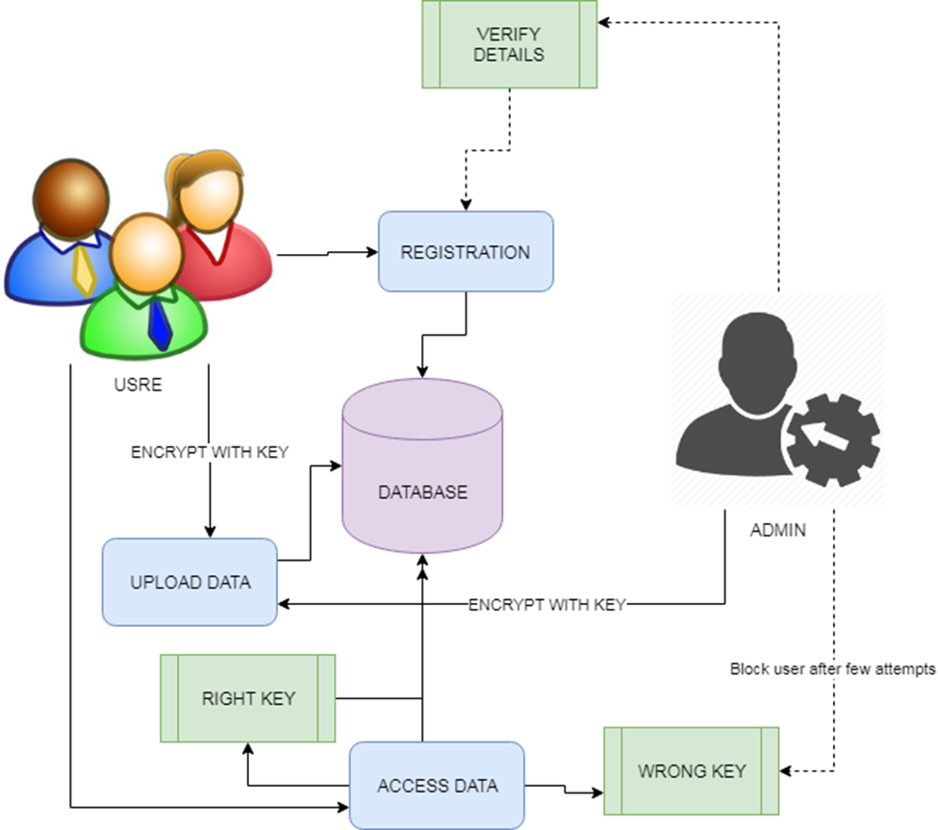
ARCHITECTURE

Slide 12
MODULES
UPLOAD DATA:
Both administrators and authorized users can securely upload data to the database with encryption keys. User authorization is managed by the administrator.
ACCESS DETAILS:
Administrators control access to data in the database and approve or disapprove user requests based on their details.

Slide 13
USER PERMISSIONS:
Only authorized users are granted access to data, and administrators can block or unblock users based on their activities and requests.
DATA ANALYSIS:
Graph-based data analysis provides insights and predictions for better understanding of the dataset and data policies.

Slide 14
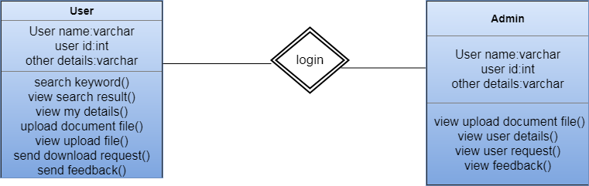
UML DIAGRAMS
CLASS DIAGRAM:

Slide 15
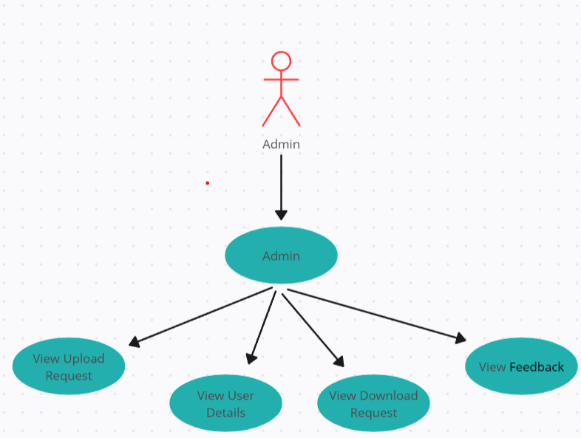
USE CASE DIAGRAM:
Admin:-

Slide 16
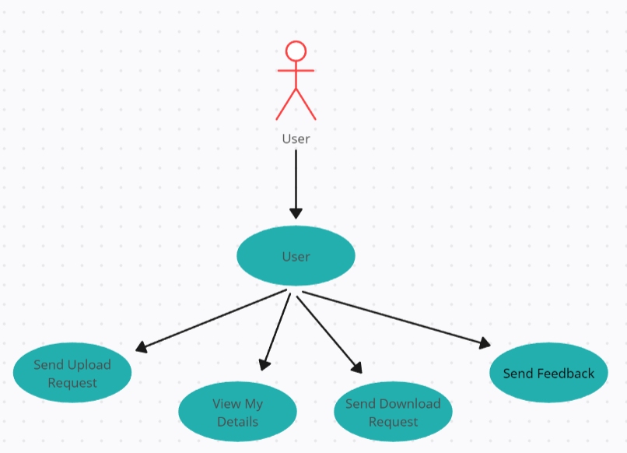
User:-

Slide 17
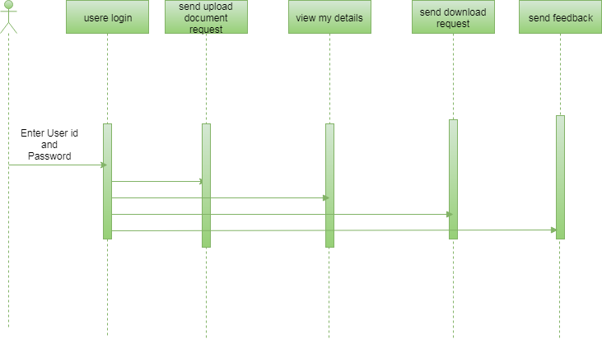
SEQUENCE DIAGRAM:
User:-

Slide 18

Admin:-

Slide 19
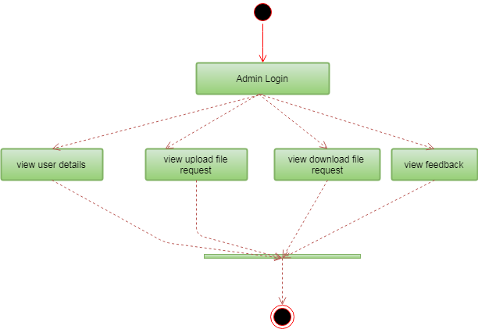
ACTIVITY DIAGRAM:
Admin:-

Slide 20
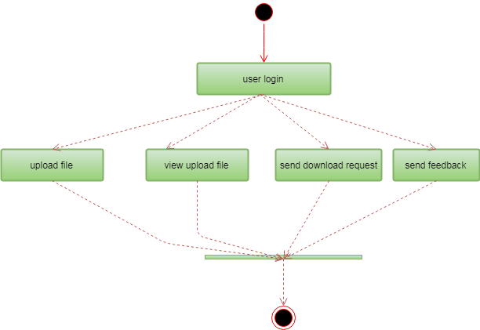
User:-

Slide 21
SAMPLE CODE:
import re
from django.contrib import messages
from django.contrib.auth import authenticate
from django.db.models import Q, Count
from django.shortcuts import render, redirect
# Create your views here.
from Cyber_Users.forms import UserRegister_Form
from Cyber_Users.models import UserRegister_Model, UserAdd_Model
def user_login(request):
if request.method == "POST":
name = request.POST.get('name')
password = request.POST.get('password')
try:
check = UserRegister_Model.objects.get(name=name,password=password)
request.session['userid'] = check.id
return redirect('user_adddata')

Slide 22
except:
pass
user = authenticate(name=name,password=password)
if user is not None:
if user.is_active:
return redirect('user_adddata')
else:
messages.error(request, 'username or password are not match')
return redirect('user_login')
return render(request, 'users/user_login.html')
def user_register(request):
if request.method == "POST":
forms = UserRegister_Form(request.POST)
if forms.is_valid():
forms.save()
messages.success(request, 'You have been successfully registered')
return redirect('user_login')
else:
forms = UserRegister_Form()
return render(request,'users/user_register.html',{'form':forms})

Slide 23
def user_adddata(request):
userid = request.session["userid"]
obj = UserRegister_Model.objects.get(id=userid)
attack1 = []
attack2, attack3, attack4, attack5, attack6, attack7, attack8, attack9 = [], [], [], [], [], [], [], []
splt = ''
Entity = ''
Year = 0
Records = ''
Organizationtype = ''
Method = ''
txt =''
Adddata = ''
ans = ''
Time = ''
if request.method == "POST":
Entity = request.POST.get("entity")
Year = request.POST.get("year")
Records = request.POST.get("records")
Organizationtype = request.POST.get("organizationtype")
Method = request.POST.get("method")
txt = request.POST.get("name")
Time = request.POST.get("time")

Slide 24
from django.db import models
# Create your models here.
class UserRegister_Model(models.Model):
name = models.CharField(max_length=50)
email = models.EmailField(max_length=30)
password = models.CharField(max_length=10)
phoneno = models.CharField(max_length=15)
address = models.CharField(max_length=500)
class UserAdd_Model(models.Model):
uregid = models.ForeignKey(UserRegister_Model)
entity = models.CharField(max_length=100)
year = models.IntegerField()
records = models.CharField(max_length=1000)
organizationtype=models.CharField(max_length=1000)
method = models.CharField(max_length=100)
adddata = models.CharField(max_length=500)
attackresult = models.CharField(max_length=500)
time = models.CharField(max_length=100)

Slide 25
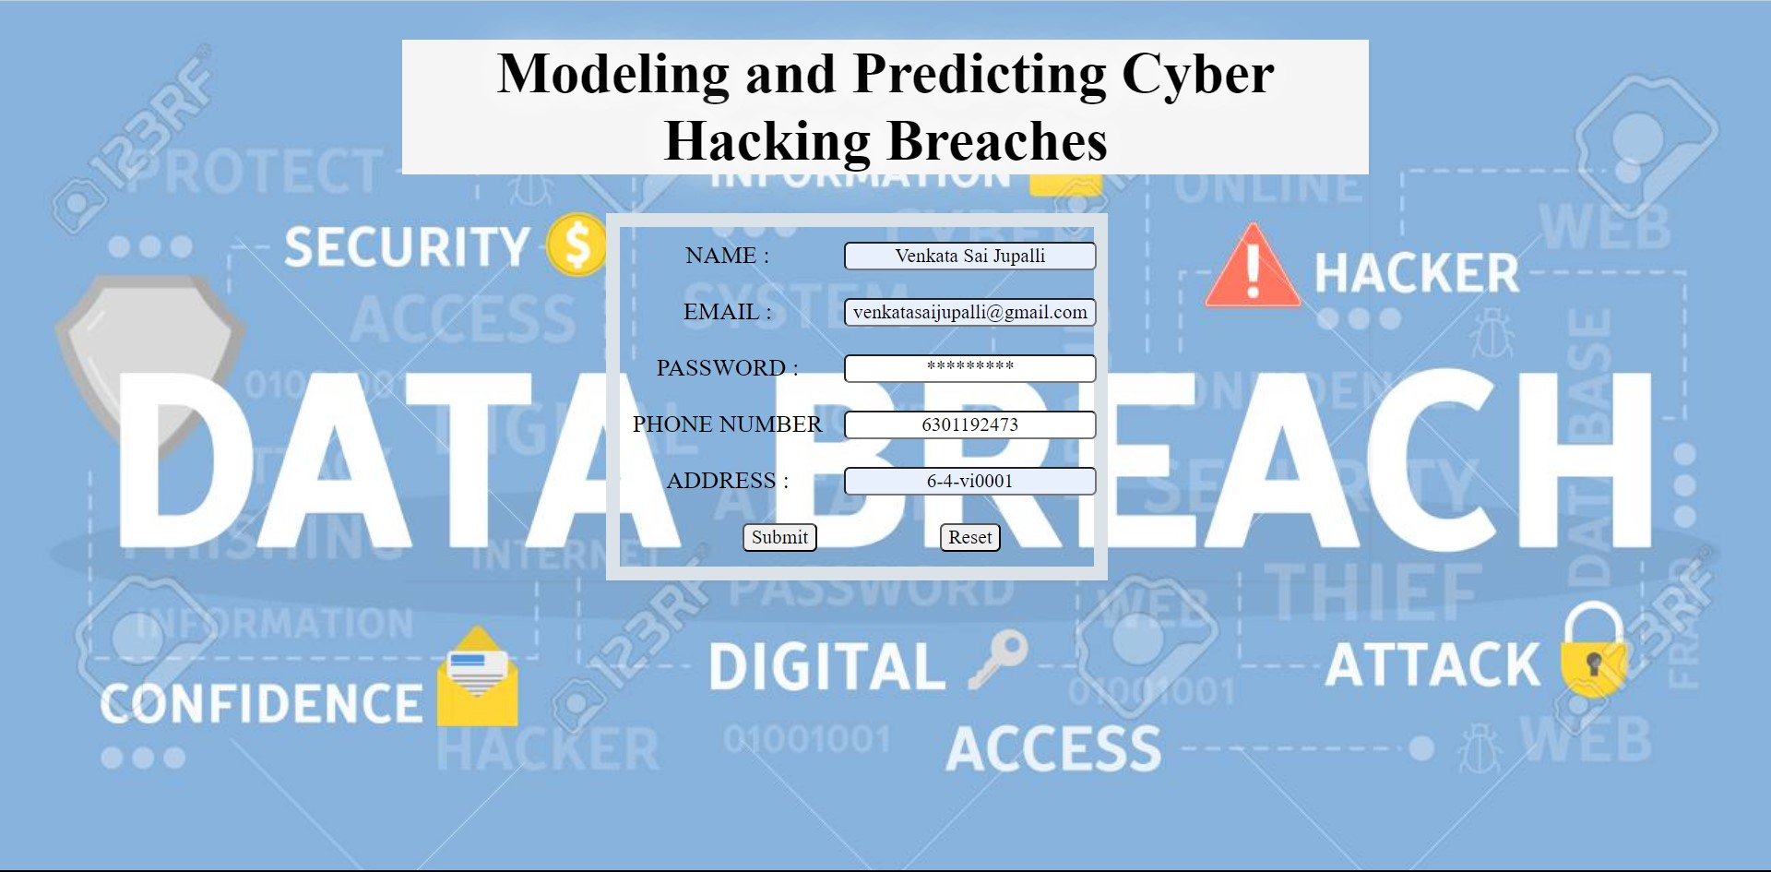
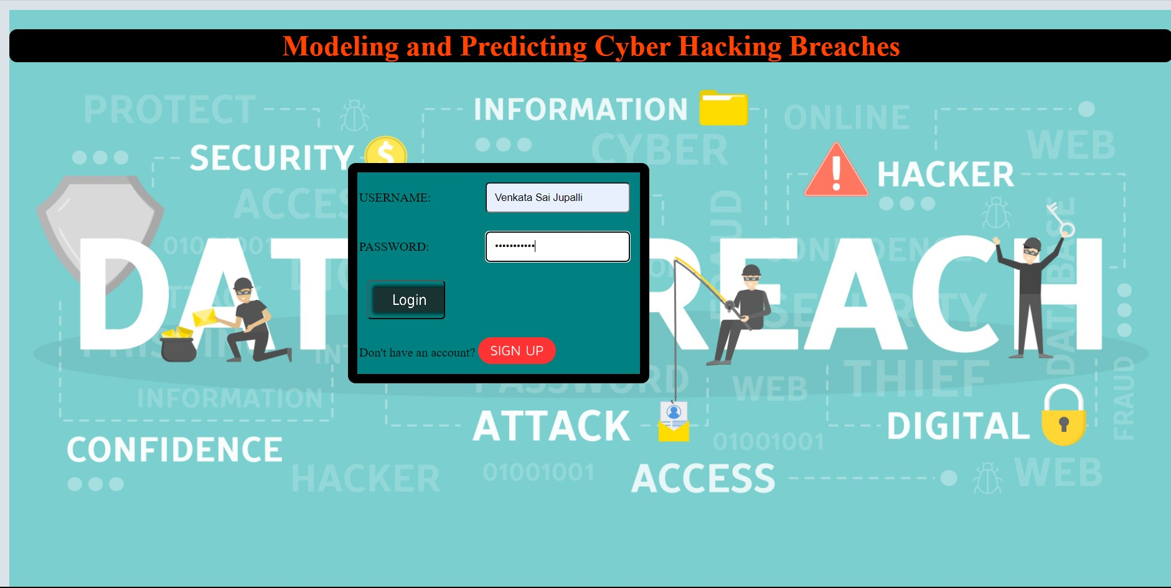
RESULTS:

Slide 26
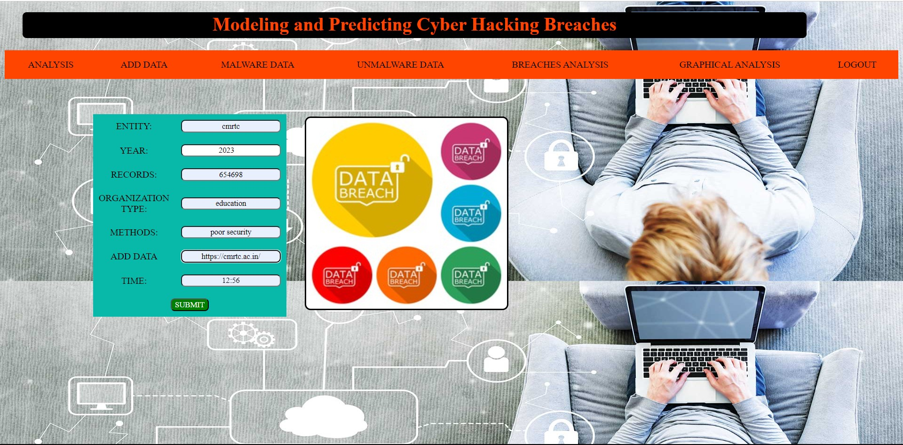
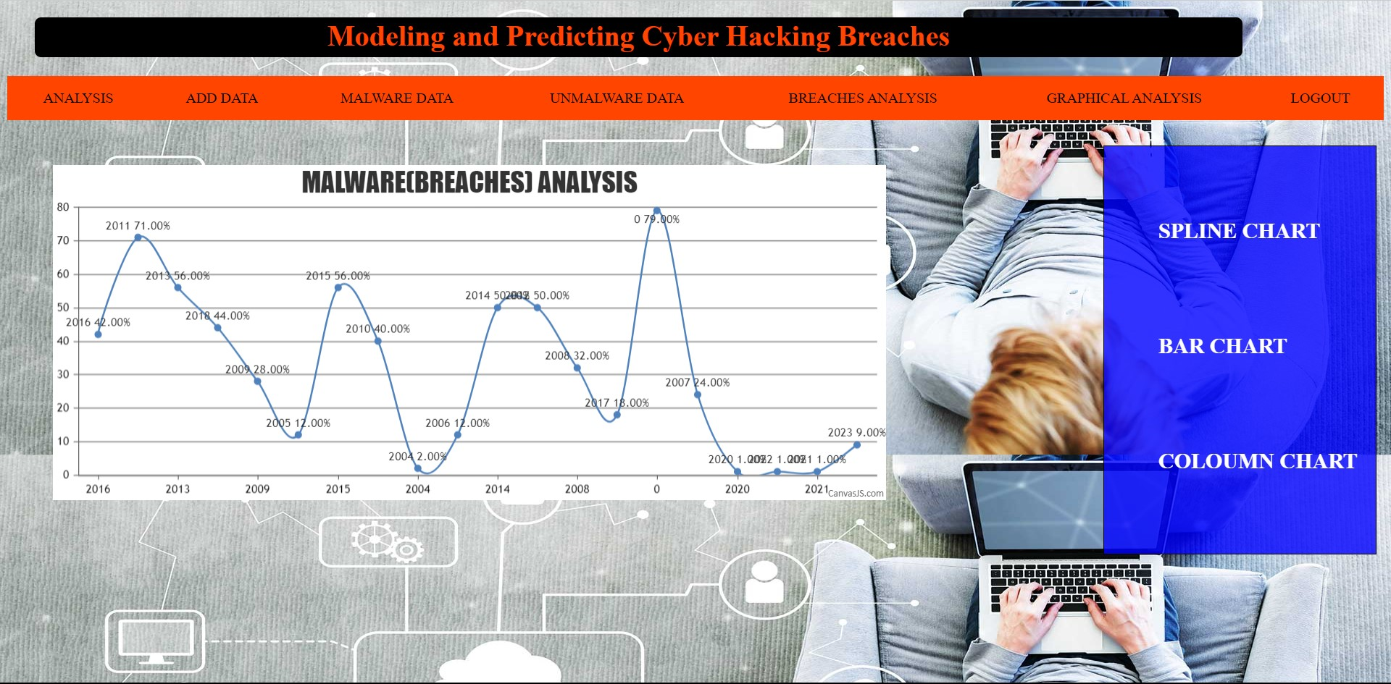

Slide 27
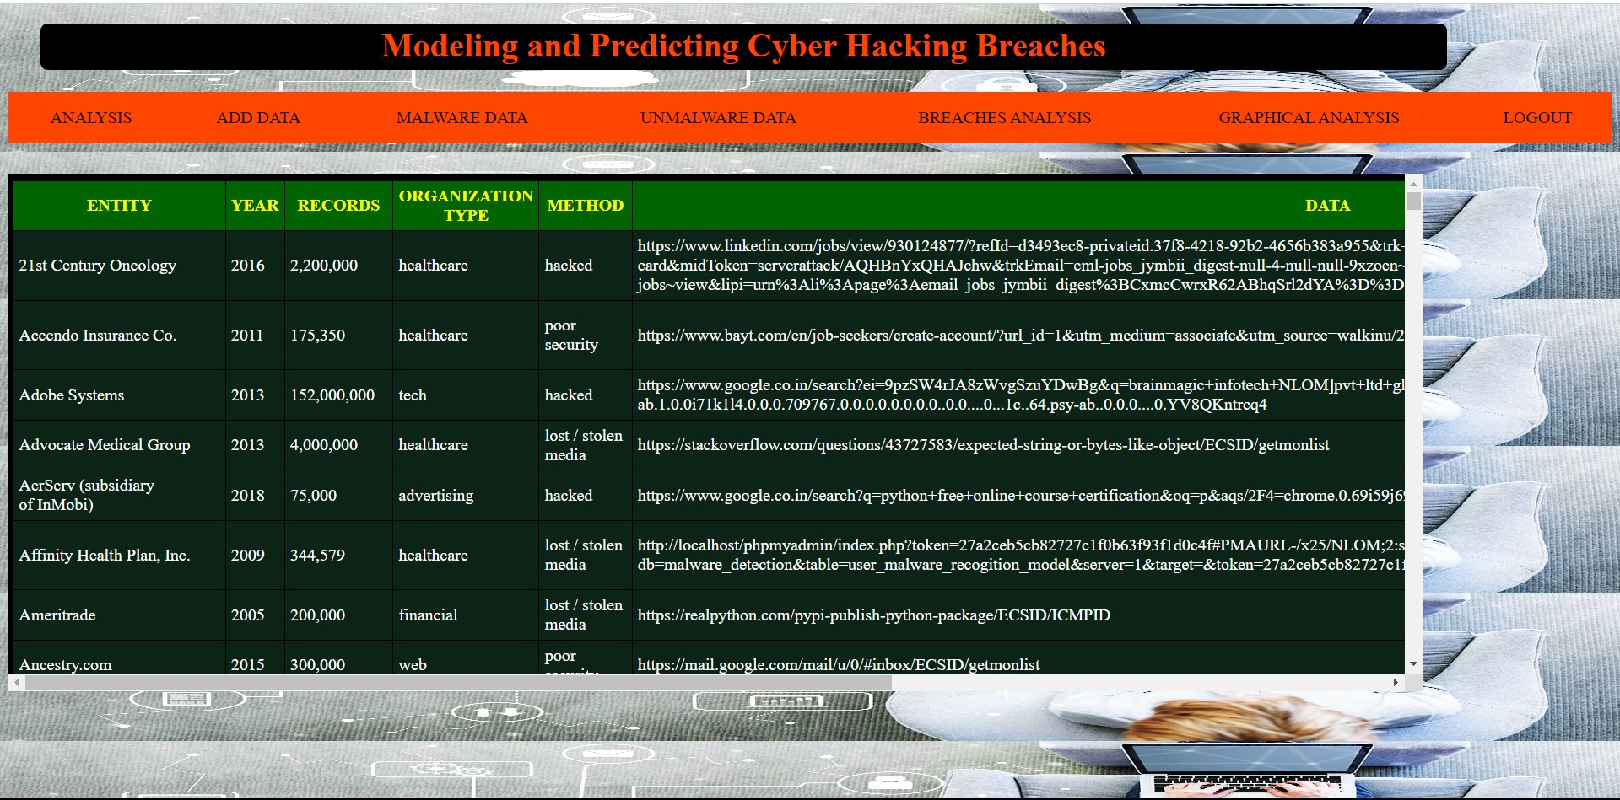
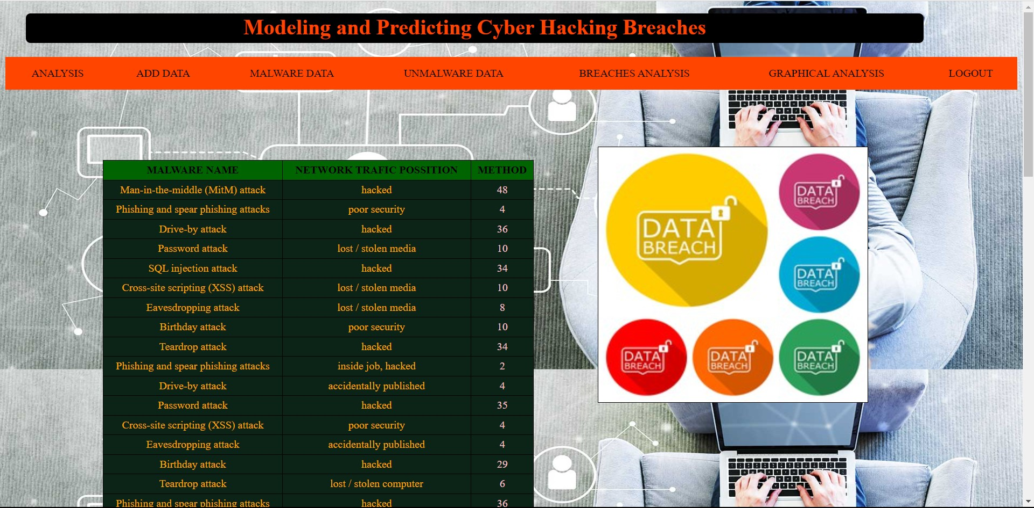

Slide 28
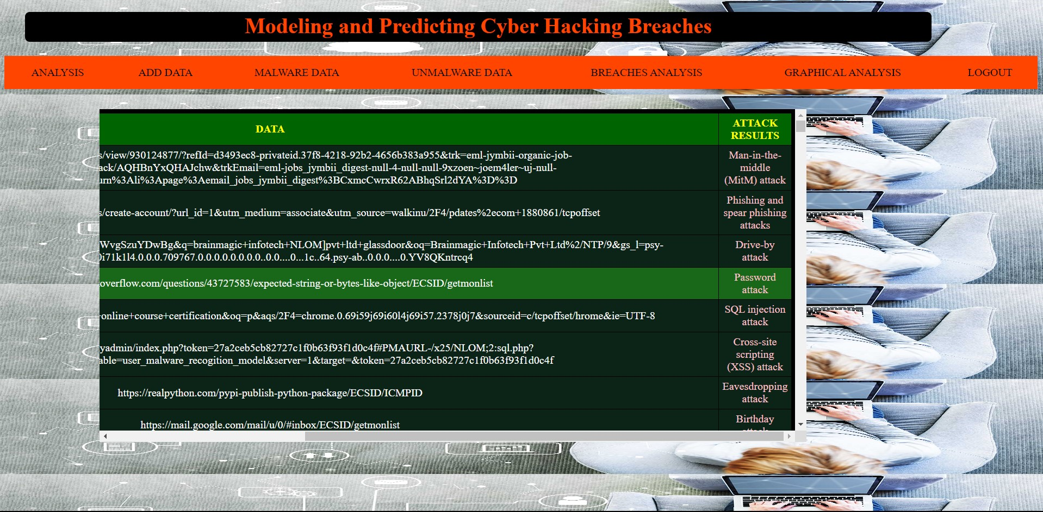
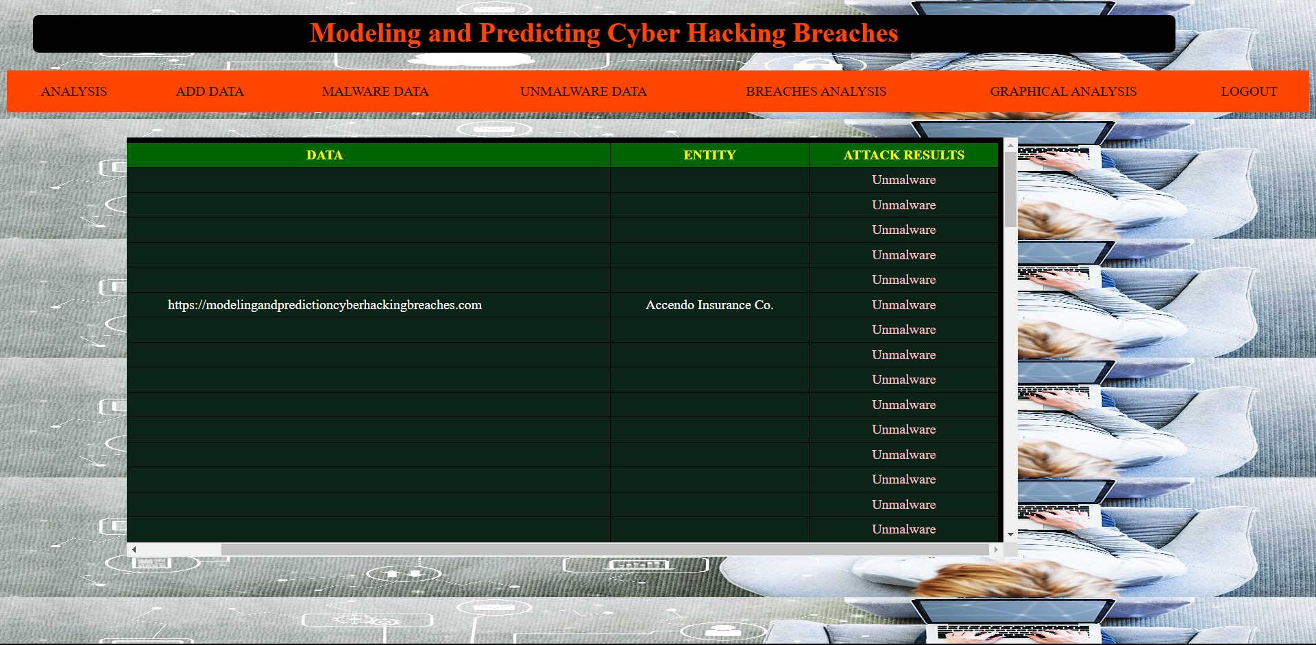

Slide 29
CONCLUSION
We analyzed a hacking breach dataset from the points of view of the incidents inter-arrival time and the breach size, and showed that they both should be modeled by stochastic processes rather than distributions. The statistical models developed in this project show satisfactory fitting and prediction accuracies.

Slide 30
FUTURE SCOPE:
The future of modeling and predicting cyber hacking breaches holds great potential with advancements in machine learning, behavioral analytics, IoT, cloud security, and quantum computing threats. As the cybersecurity landscape evolves, predictive models will play a crucial role in enhancing threat detection and prevention. Collaboration, compliance, and ethical considerations will also be significant factors in shaping this field

Slide 31
REFERENCES:
[1] P. R. Clearinghouse, “Privacy rights clearinghouse’s chronology of data breaches.” https://www.privacyrights.org/data-breaches, Last accessed on November 9, 2017.
[2] I. T. R. Center, “http://www.idtheftcenter.org/2016databreaches.html.”
[3] C. R. Center, “Cybersecurity incidents.” https://www.opm.gov/ cybersecurity/cybersecurity-incidents/, Last accessed on November 9, 2017.
[4] I. Security, “https://www.ibm.com/security/data-breach/index.html.”
[5] N. . C. C. Study, “https://netdiligence.com/wp-content/uploads/2016/10/ P02 NetDiligence-2016-Cyber-Claims-Study-ONLINE.pdf.”
[6] M. Eling and W. Schnell, “What do we know about cyber risk and cyber risk insurance?,” The Journal of Risk Finance, vol. 17, no. 5, pp. 474– 491, 2016.
[7] T. Maillart and D. Sornette, “Heavy-tailed distribution of cyber-risks,” The European Physical Journal B-Condensed Matter and Complex Systems, vol. 75, no. 3, pp. 357–364, 2010.

Slide 32
GITHUB LINK:
https://github.com/venkatasairao/MODELING-AND-PREDICTING-CYBER-HACKING-BREACHES

Slide 33

Thank you..!

